Slide 1
Baseball Statistics
By Brian Bargas, German Martinez, Chris Pena

Slide 2
DATA

Slide 3
Source
Sean Lahman Online Baseball Database
1871 to 2014
Several different baseball stats including;
Plus Fielding Statistics
Standings
Team Stats
Managerial Records
Post-Season Data
Salary
Pitching
Bating
Player Personal Info

Slide 4
CSV
Master
Batting
Salary
Hall Of Fame
Teams
Franchise
Joined using a player.id or team.id

Slide 5
Tableau Visualizations

Slide 6
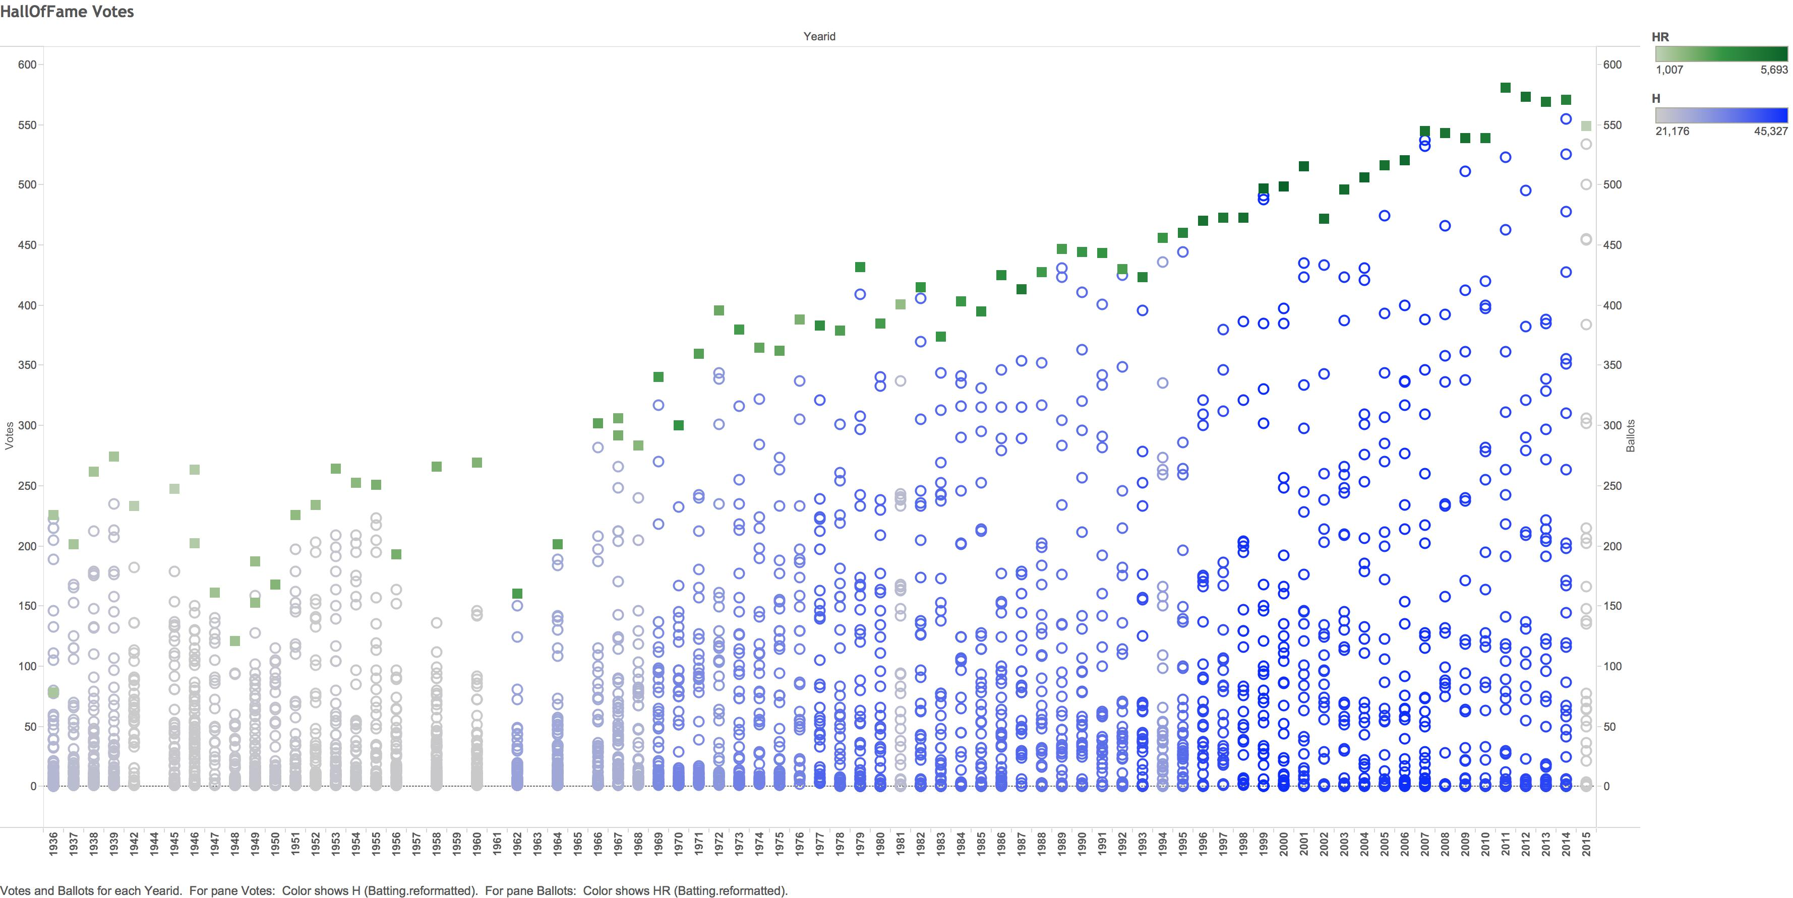
Hall of Fame Votes

Slide 7
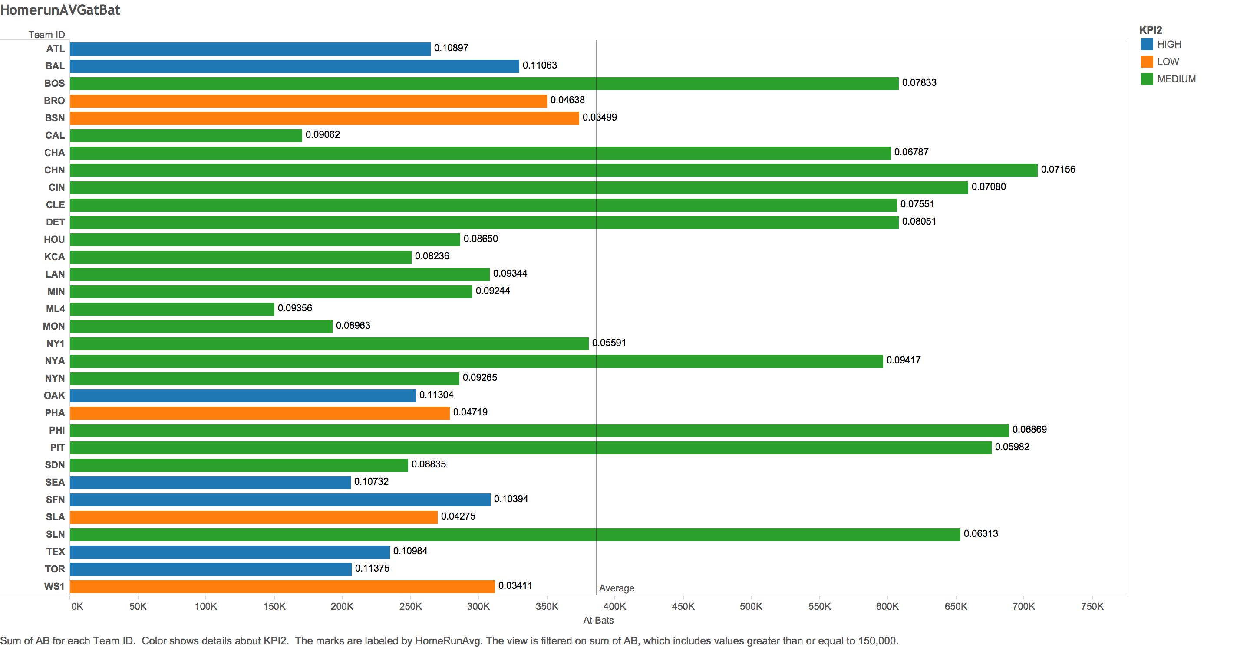
Homeruns Average per Hit

Slide 8
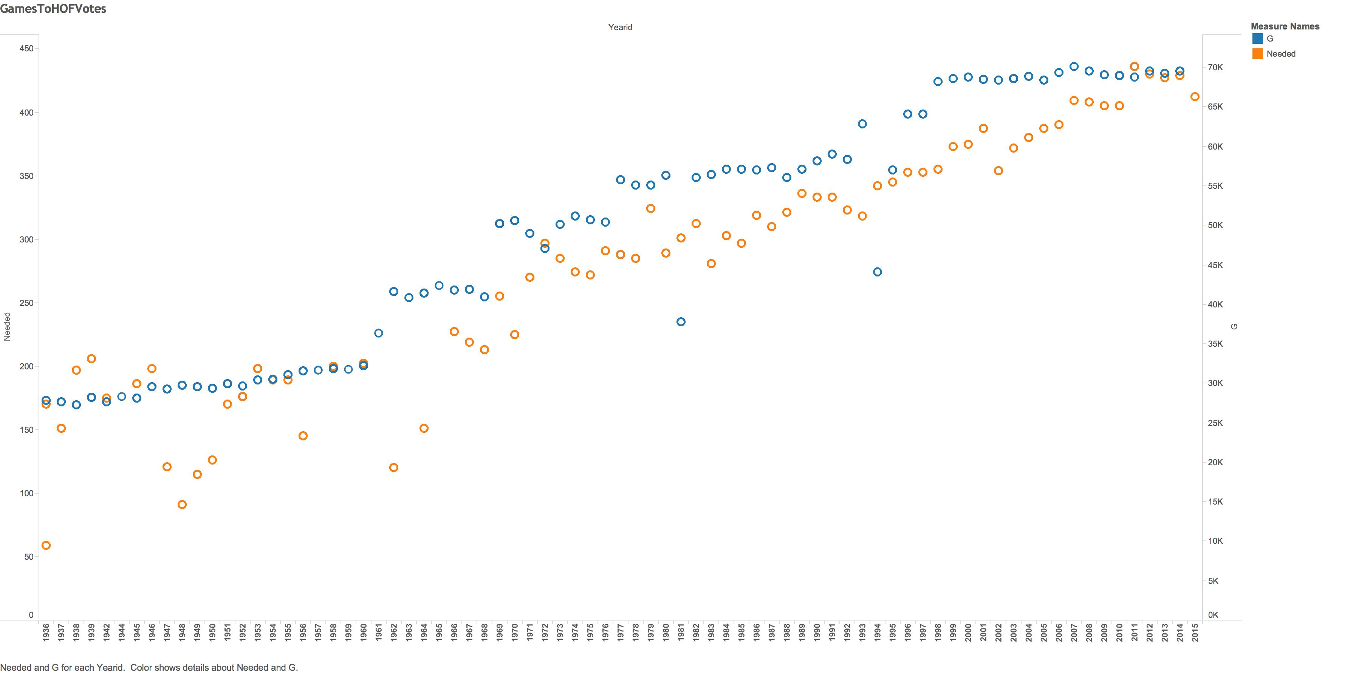
Number of Games vs Hall of Fame Votes

Slide 9
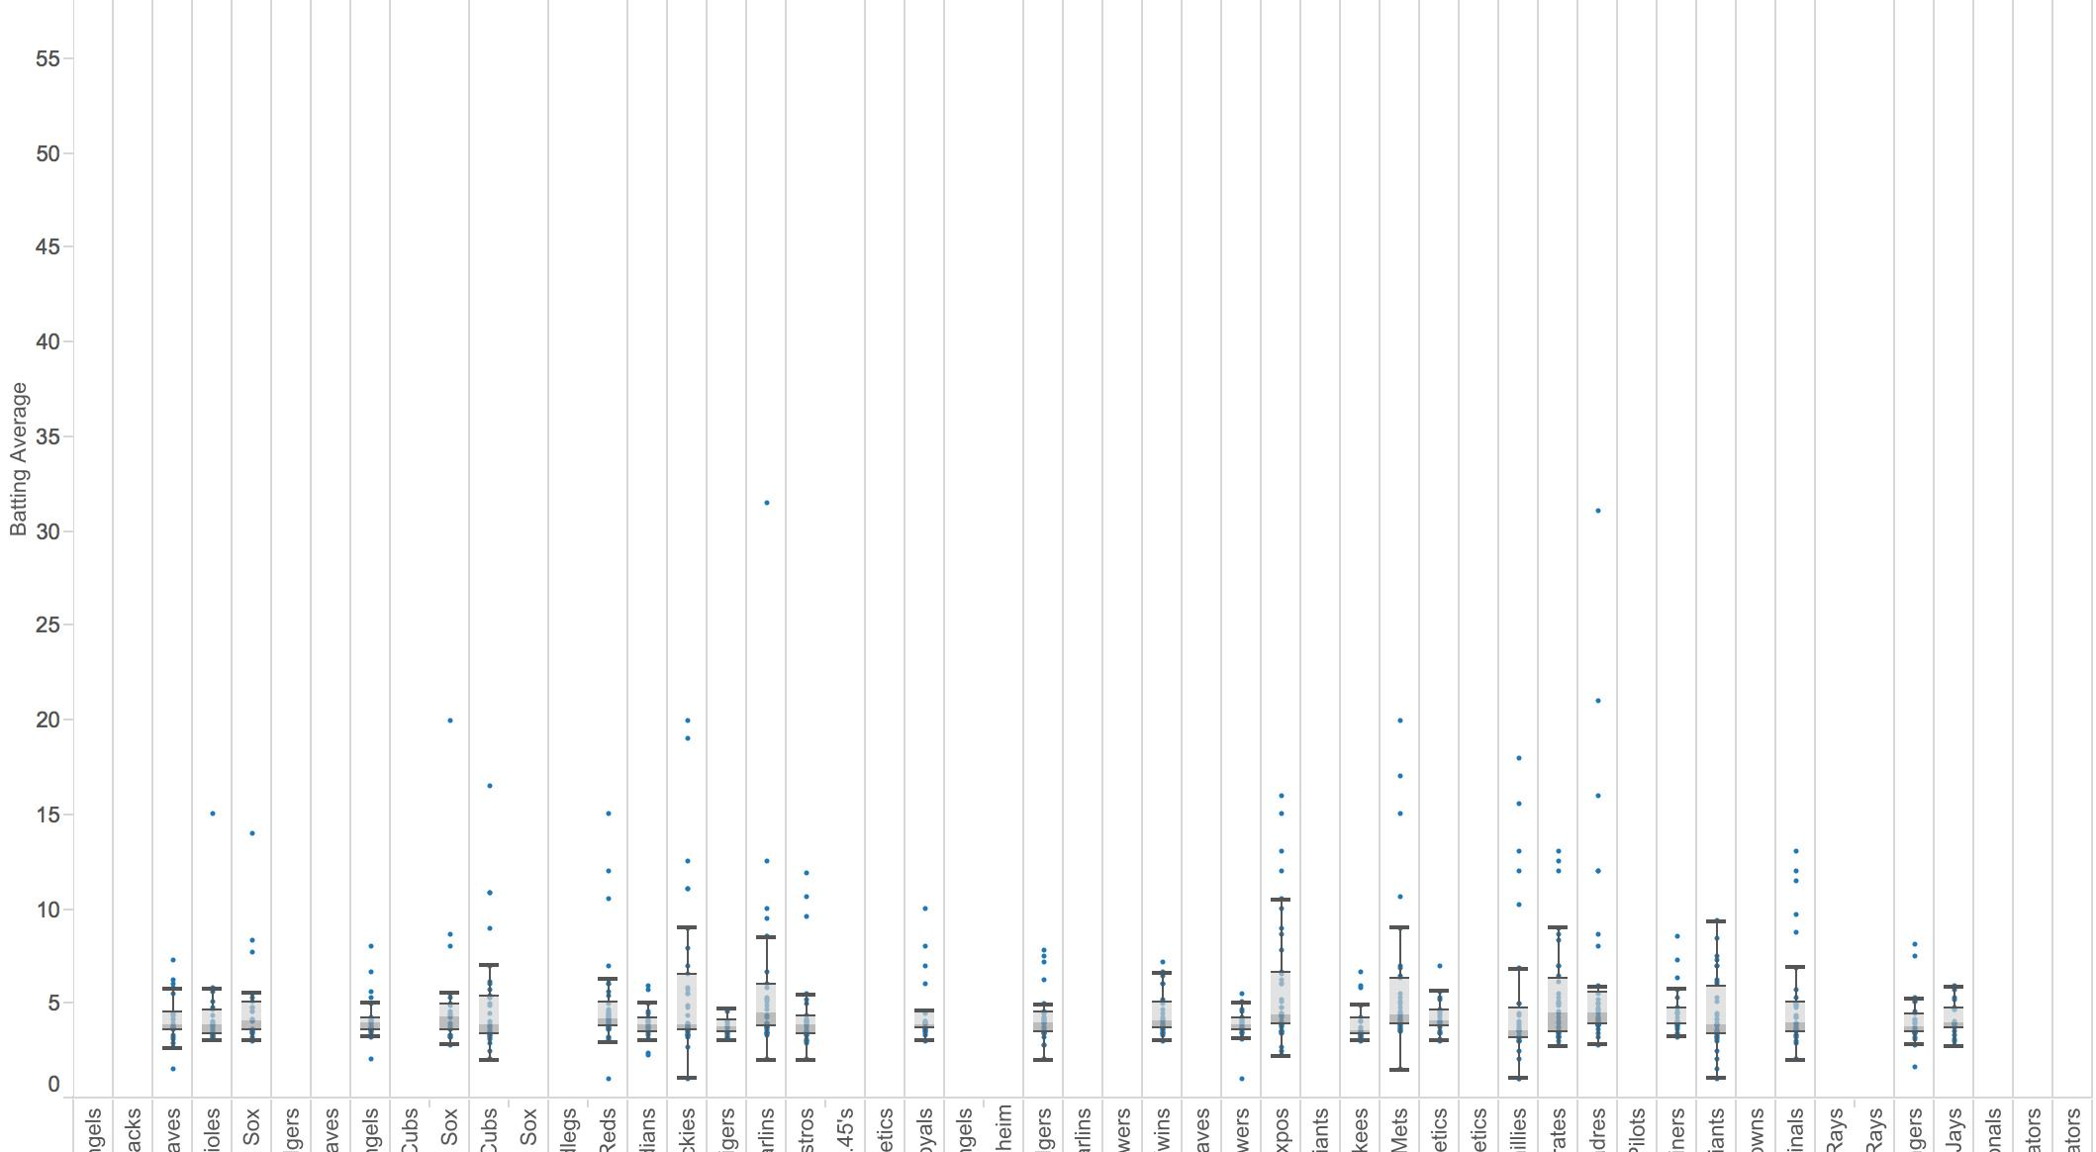
Team Batting Averages

Slide 10
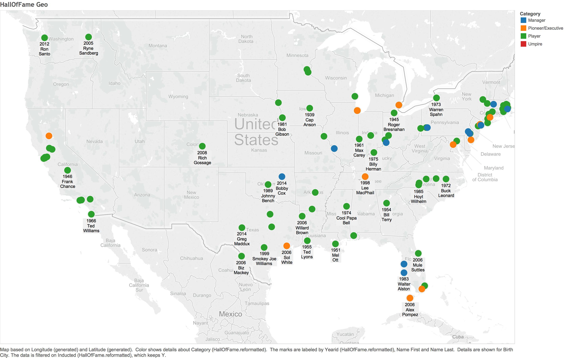
Hall of Fame by City

Slide 11
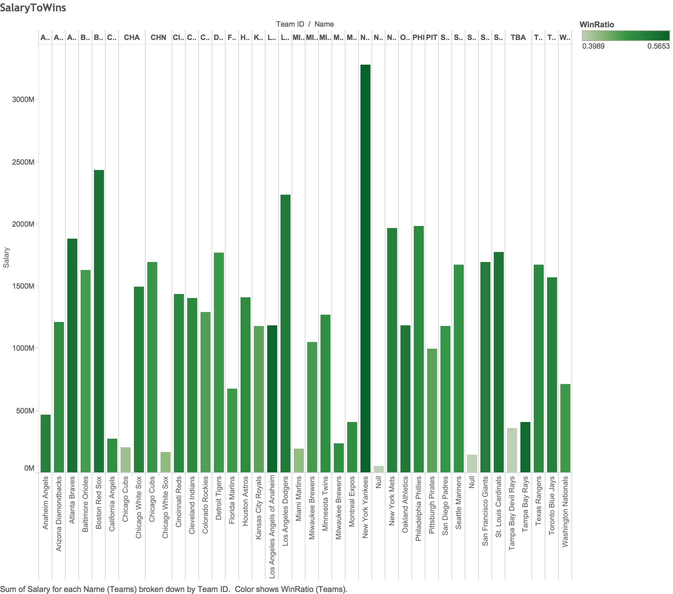
Salary to Wins

Slide 12
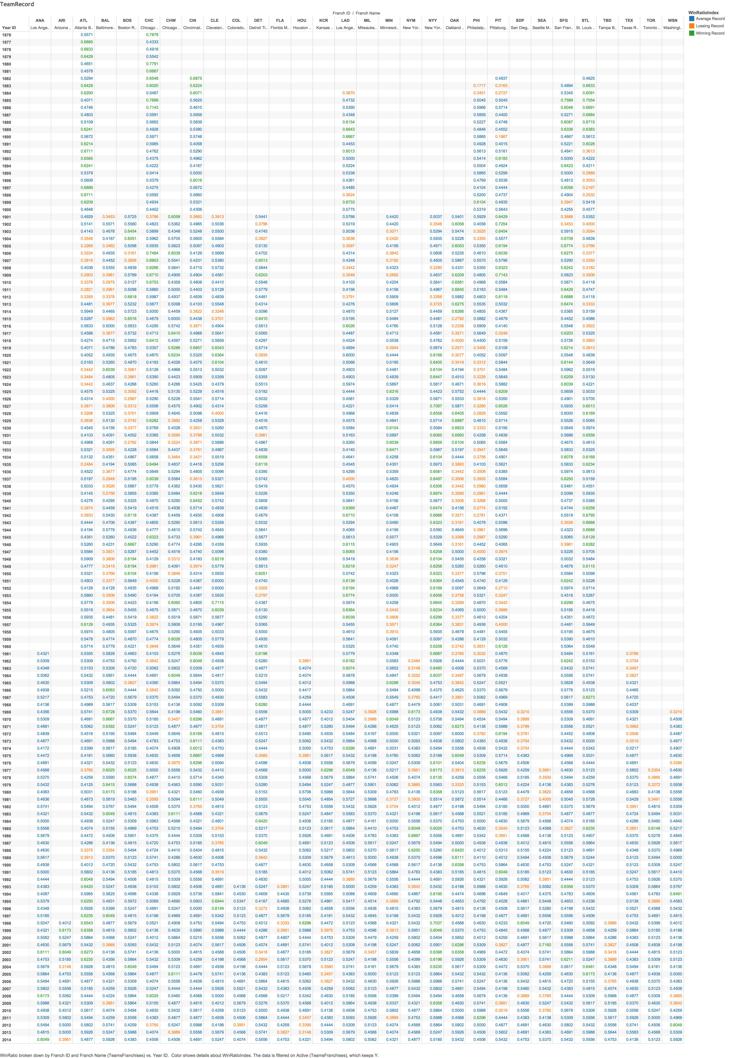
Team Records

Slide 13
Shiny

Slide 14
Server
Event reactive
Render Plot
Observe Event

Slide 15
UI
Dashboard
Sidebar w/ Cross Tab
Body
User Created Parameter

Slide 16
Link
https://bswass.shinyapps.io/04Shiny

Slide 17
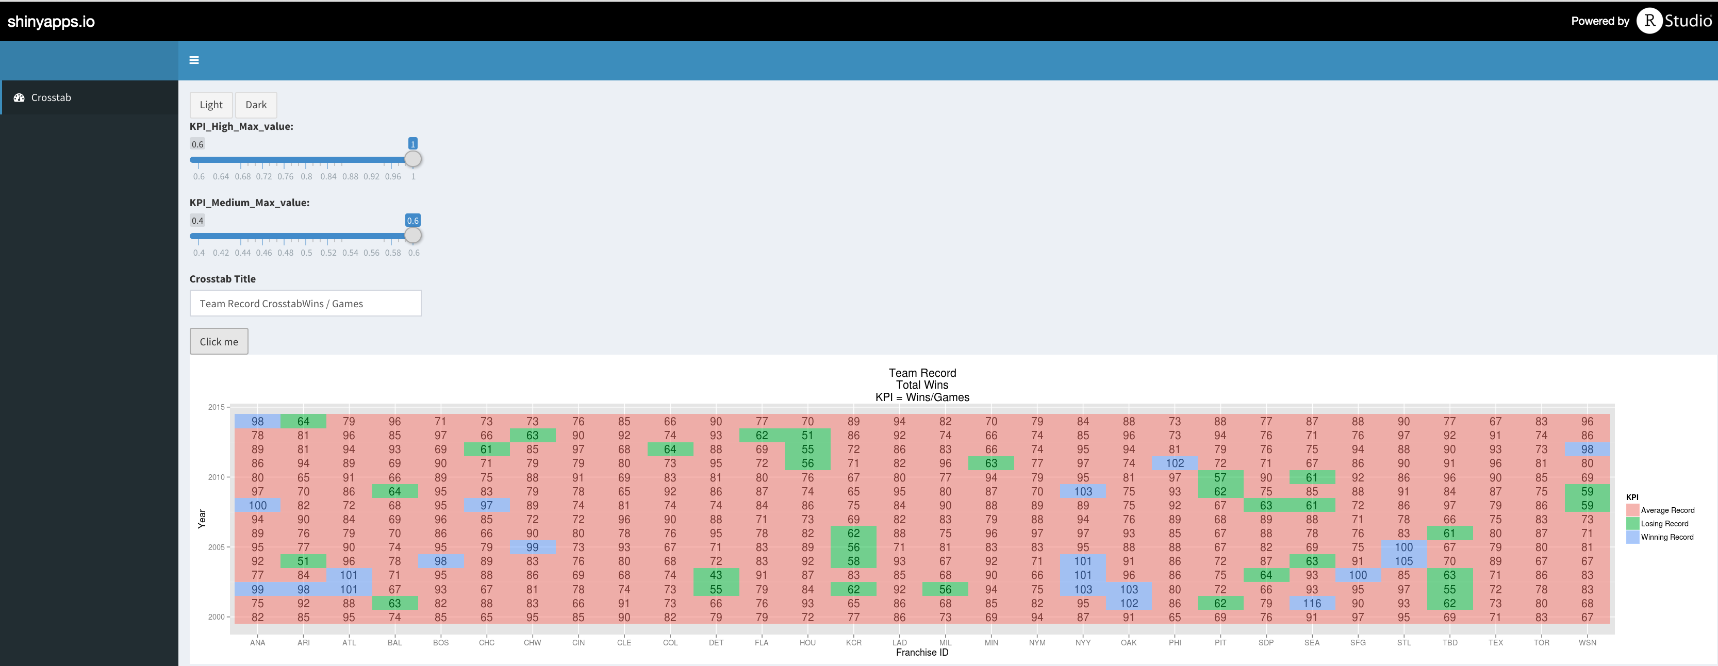
Link

Slide 18
RMD Markdown

Slide 19
Link
file://localhost/Users/GermanMtz/Documents/Academic/CompSci/Data/FinalProject/DV_FinalProject/00%20Doc/DV_FinalProject.html

Slide 20
Questions, Comments, Complements?

